Slide 1
Structuring System Process Requirements

Slide 2
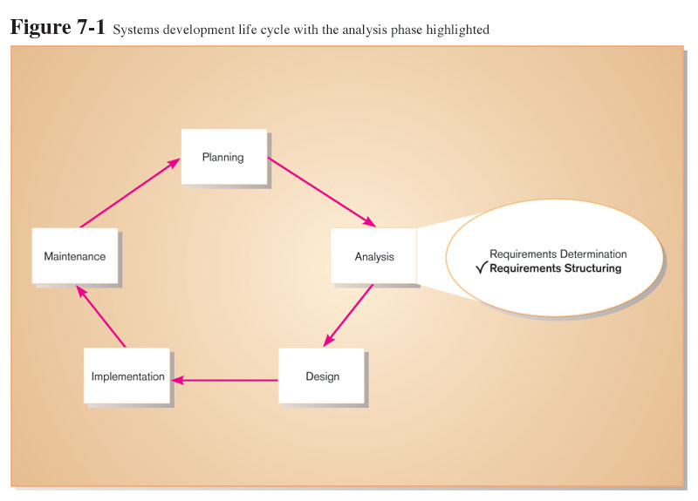
Process Modeling

Slide 3
Process Modeling (Cont.)
Graphically represent the processes that capture, manipulate, store, and distribute data between a system and its environment and among system components.

Slide 4
Process Modeling (Cont.)
Utilize information gathered during requirements determination.
Processes and data structures are modeled.

Slide 5
Deliverables and Outcomes
Context data flow diagram (DFD)
Scope of system.
DFDs of current physical system
Adequate detail only.
DFDs of current logical system
Enables analysts to understand current system.

Slide 6
Deliverables and Outcomes (Cont.)
DFDs of new logical system
Technology independent.
Show data flows, structure, and functional requirements of new system.
Thorough description of each DFD component

Slide 7
Data Flow Diagramming Mechanics
Represent both physical and logical information systems.
Only four symbols are used.

Slide 8
Data Flow Diagramming Mechanics (Cont.)
Useful for depicting purely logical information flows.
DFDs that detail physical systems differ from system flowcharts which depict details of physical computing equipment.

Slide 9
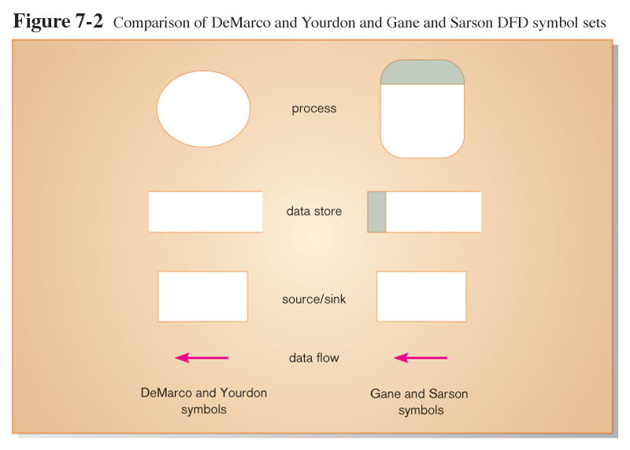
Definitions and Symbols

Slide 10
Definitions and Symbols (Cont.)
Process: work or actions performed on data (inside the system).
Data store: data at rest (inside the system).

Slide 11
Definitions and Symbols (Cont.)
Source/sink: external entity that is origin or destination of data (outside the system).
Data flow: arrows depicting movement of data.

Slide 12
Developing DFDs
Context diagram is an overview of an organizational system that shows:
the system boundaries.
external entities that interact with the system.
Major information flows between the entities and the system.
Note: only one process symbol, and no data stores shown.

Slide 13
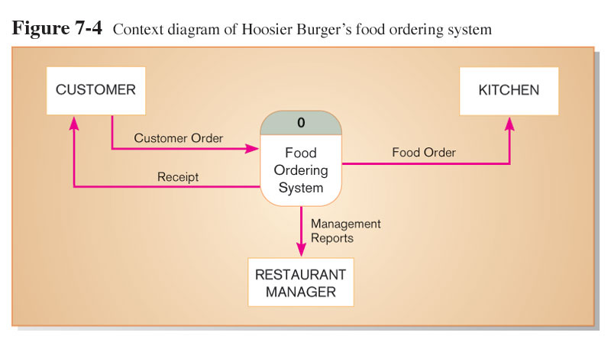
Context Diagram

Slide 14
Developing DFDs (Cont.)
Level-0 diagram is a data flow diagram that represents a system’s major processes, data flows, and data stores at a high level of detail.
Processes are labeled 1.0, 2.0, etc. These will be decomposed into more primitive (lower-level) DFDs.

Slide 15
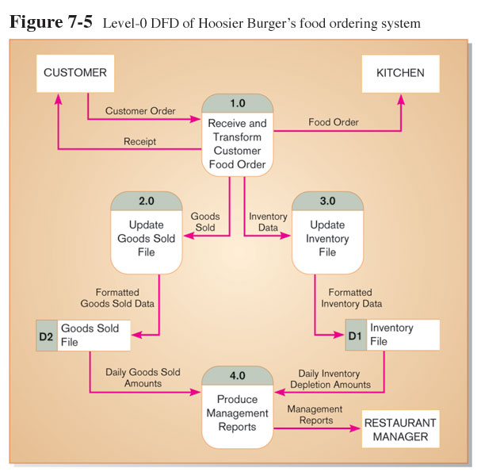
Level-0 Diagram

Slide 16
Data Flow Diagramming Rules
There are two DFD guidelines that apply:
The inputs to a process are different from the outputs of that process.
Processes purpose is to transform inputs into outputs.
Objects on a DFD have unique names.
Every process has a unique name.

Slide 17
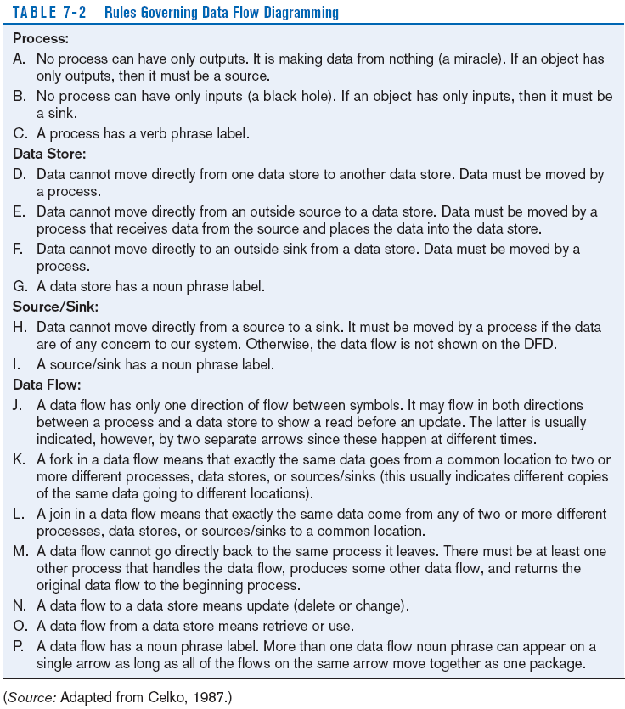
Data Flow Diagramming Rules (Cont.)

Slide 18
Decomposition of DFDs
Functional decomposition is an iterative process of breaking a system description down into finer and finer detail.
Creates a set of charts in which one process on a given chart is explained in greater detail on another chart.
Continues until no sub process can logically be broken down any further.

Slide 19
Decomposition of DFDs (Cont.)
Primitive DFD is the lowest level of a DFD.
Level-1 diagram results from decomposition of Level-0 diagram.
Level-n diagram is a DFD diagram that is the result of a n nested decompositions from a process on a level-0 diagram.

Slide 20
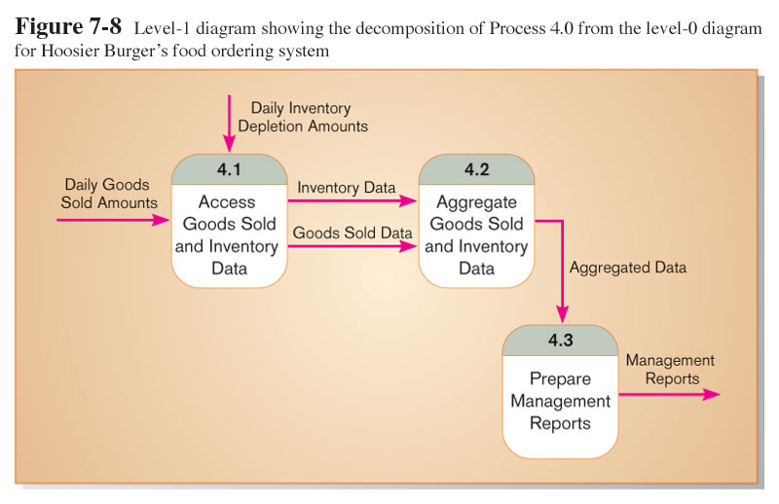
Level-1 DFD
Level-1 DFD shows the sub-processes of one of the processes in the Level-0 DFD.
This is a Level-1 DFD for Process 4.0.
Processes are labeled 4.1, 4.2, etc. These can be further decomposed in more primitive (lower-level) DFDs if necessary.

Slide 21
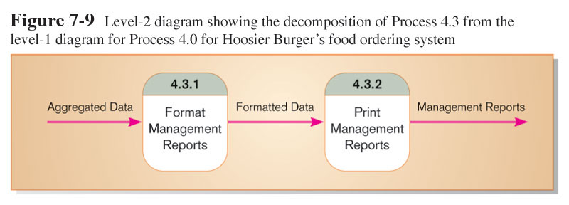
Level-n DFD
Level-n DFD shows the sub-processes of one of the processes in the Level n-1 DFD.
This is a Level-2 DFD for Process 4.3.
Processes are labeled 4.3.1, 4.3.2, etc. If this is the lowest level of the hierarchy, it is called a primitive DFD.

Slide 22
Balancing DFDs
Conservation Principle: conserve inputs and outputs to a process at the next level of decomposition.
Balancing: conservation of inputs and outputs to a data flow diagram process when that process is decomposed to a lower level.

Slide 23
Balancing DFDs (Cont.)
Balanced means:
Number of inputs to lower level DFD equals number of inputs to associated process of higher-level DFD
Number of outputs to lower level DFD equals number of outputs to associated process of higher-level DFD

Slide 24
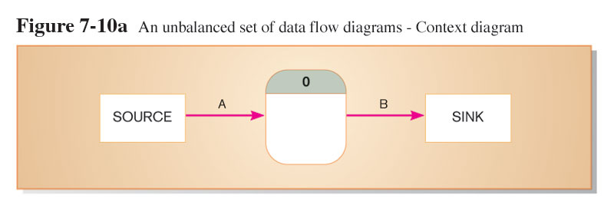
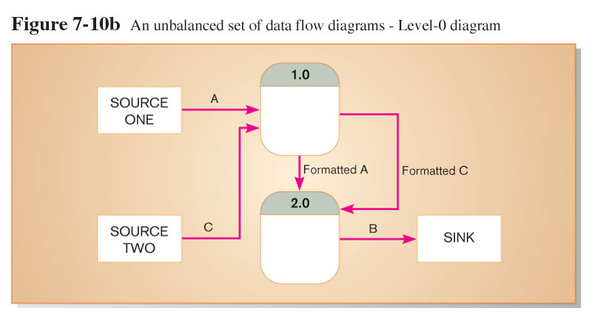
Balancing DFDs (Cont.)
1 input
1 output
This is unbalanced because the process of the context diagram has only one input but the Level-0 diagram has two inputs.
2 inputs
1 output

Slide 25
Balancing DFDs (Cont.)
Data flow splitting is when a composite data flow at a higher level is split and different parts go to different processes in the lower level DFD.
The DFD remains balanced because the same data is involved, but split into two parts.

Slide 26
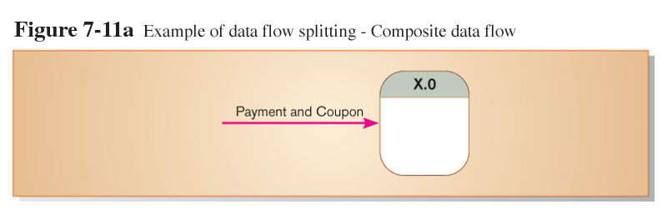
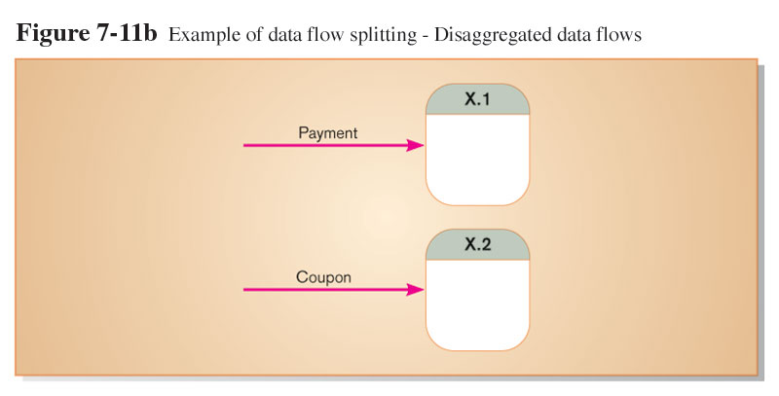
Balancing DFDs (Cont.)

Slide 27
Four Different Types of DFDs
Current Physical
Process labels identify technology (people or systems) used to process the data.
Data flows and data stores identify actual name of the physical media.
Current Logical
Physical aspects of system are removed as much as possible.
Current system is reduced to data and processes that transform them.

Slide 28
Four Different Types of DFDs (Cont.)
New Logical
Includes additional functions.
Obsolete functions are removed.
Inefficient data flows are reorganized.
New Physical
Represents the physical implementation of the new system.

Slide 29
Guidelines for Drawing DFDs (Cont.)
Completeness
DFD must include all components necessary for system.
Each component must be fully described in the project dictionary or CASE repository.
Consistency
The extent to which information contained on one level of a set of nested DFDs is also included on other levels.

Slide 30
Guidelines for Drawing DFDs (Cont.)
Timing
Time is not represented well on DFDs.
Best to draw DFDs as if the system has never started and will never stop.
Iterative Development
Analyst should expect to redraw diagram several times before reaching the closest approximation to the system being modeled.

Slide 31
Guidelines for Drawing DFDs (Cont.)
Primitive DFDs
Lowest logical level of decomposition.
Decision has to be made when to stop decomposition.

Slide 32
Guidelines for Drawing DFDs (Cont.)
Rules for stopping decomposition
When each process has been reduced to a single decision, calculation or database operation.
When each data store represents data about a single entity.

Slide 33
Guidelines for Drawing DFDs (Cont.)
When the system user does not care to see any more detail.
When every data flow does not need to be split further to show that data are handled in various ways.

Slide 34
Guidelines for Drawing DFDs (Cont.)
When you believe that you have shown each business form or transaction, online display and report as a single data flow.
When you believe that there is a separate process for each choice on all lowest-level menu options.

Slide 35
Using DFDs as Analysis Tools
Gap Analysis is the process of discovering discrepancies between two or more sets of data flow diagrams or discrepancies within a single DFD.
Inefficiencies in a system can often be identified through DFDs.

Slide 36
Logic Modeling
Data flow diagrams do not show the logic inside the processes.
Logic modeling involves representing internal structure and functionality of processes depicted on a DFD.
Logic modeling can also be used to show when processes on a DFD occur.

Slide 37
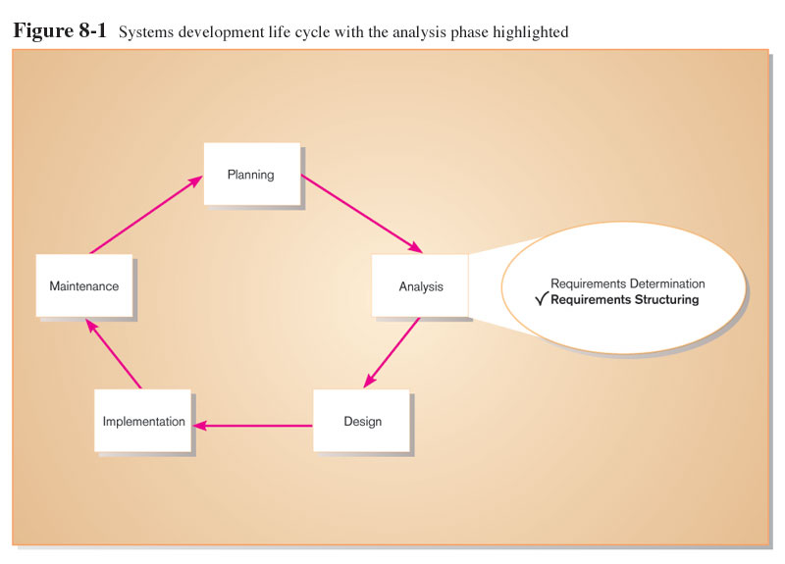
Modeling a System’s Logic

Slide 38
Deliverables and Outcomes
Structured English representation of process logic.
Decision Tables representation.
Sequence diagram.
Activity diagram.

Slide 39
Modeling Logic with Structured English
Structured English: modified form of English language used to specify the logic of information system processes.
No single standard.
Typically relies on action verbs and noun phrases and contains no adjectives or No specific standards.

Slide 40
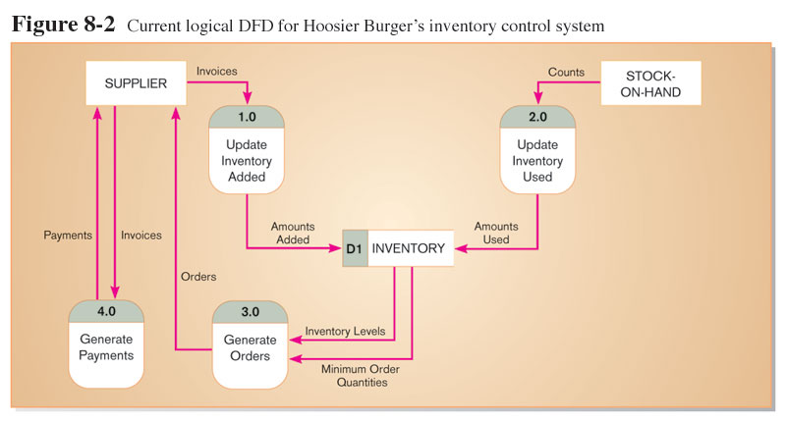
Modeling Logic with Structured English (Cont.)

Slide 41
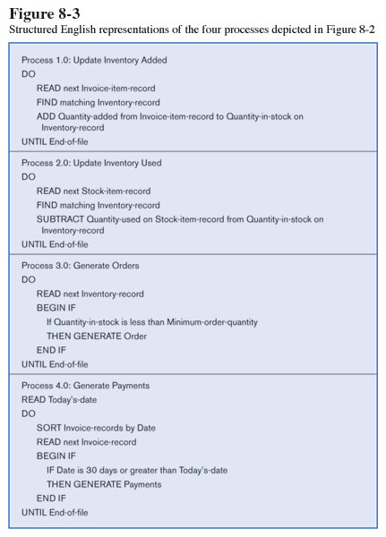
Modeling Logic with Structured English (Cont.)

Slide 42
Modeling Logic with Decision Tables
Decision table: a matrix representation of the logic of a decision which specifies the possible conditions for the decision and the resulting actions.
Best used for complicated decision logic.

Slide 43
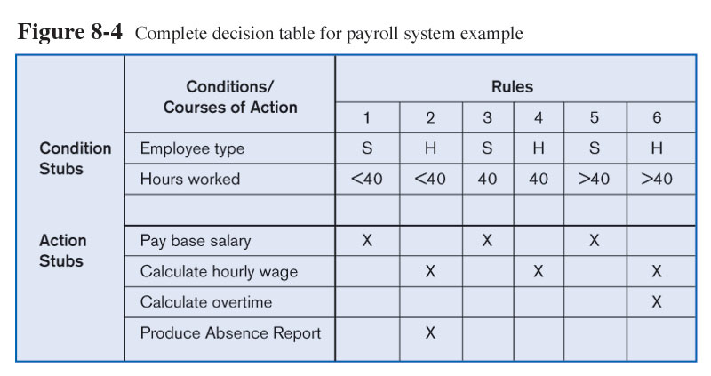
Modeling Logic with Decision Tables (Cont.)

Slide 44
Modeling Logic with Decision Tables (Cont.)
Condition stubs: that part of a decision table that lists the conditions relevant to the decision.
Action stubs: that part of a decision table that lists the actions that result for a given set of conditions.

Slide 45
Modeling Logic with Decision Tables (Cont.)
Rules: that part of a decision table that specifies which actions are to be followed for a given set of condition.
Indifferent condition: in a decision table, a condition whose value does not affect which actions are taken for two or more rules.

Slide 46
Modeling Logic with Decision Tables (Cont.)
Procedure for Creating Decision Tables
Name the condition and the values that each condition can assume.
Name all possible actions that can occur.
List all possible rules.
Define the actions for each rule.
Simplify the table.

Slide 47
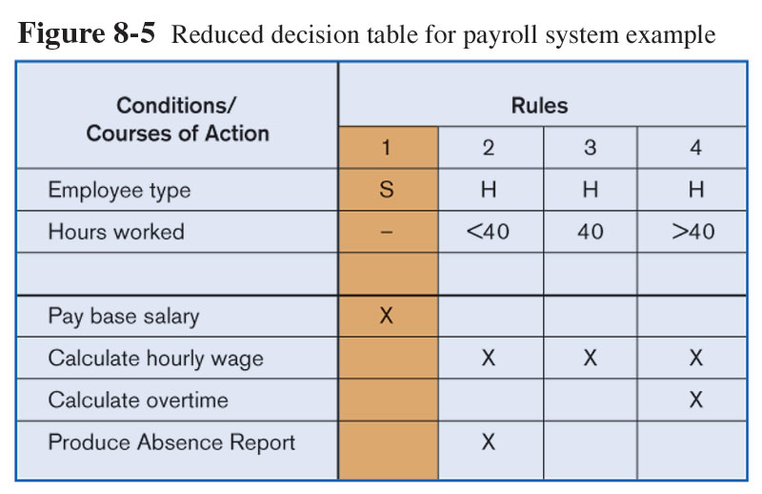
Modeling Logic with Decision Tables (Cont.)

Slide 48
Deciding Among Structured English and Decision Tables
Criteria | Structured English | Decision Tables
Determining Conditions and Actions | Second Best | Third Best
Transforming Conditions and Actions into Sequence | Best | Third Best
Checking Consistency and Completeness | Third Best | Best

Slide 49
Decision Tree
A decision tree is a support tool with a tree-like structure that models probable outcomes, cost of resources, utilities, and possible consequences. Decision trees provide a way to present algorithms with conditional control statements. They include branches that represent decision-making steps that can lead to a favorable result.

Slide 50
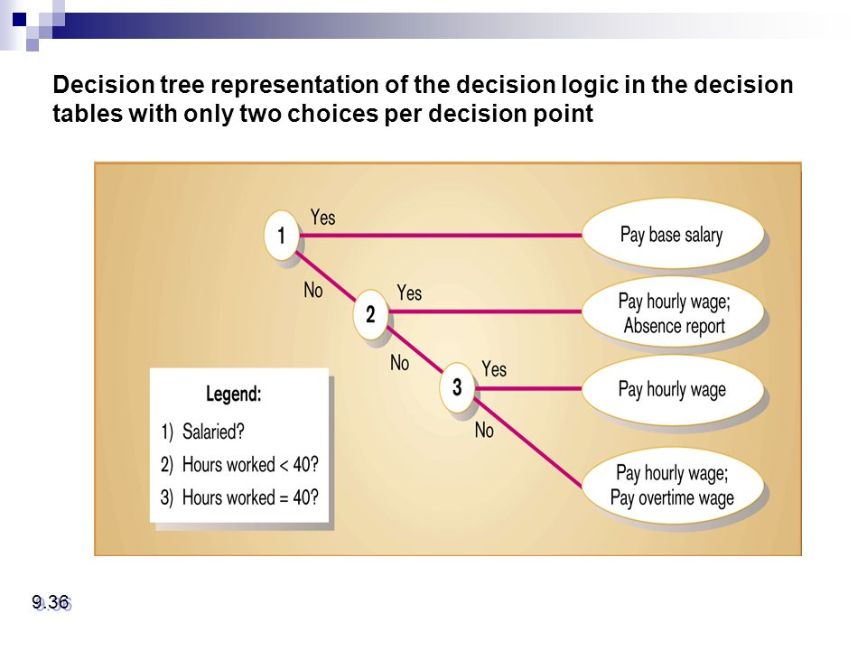
Contd.

Slide 51
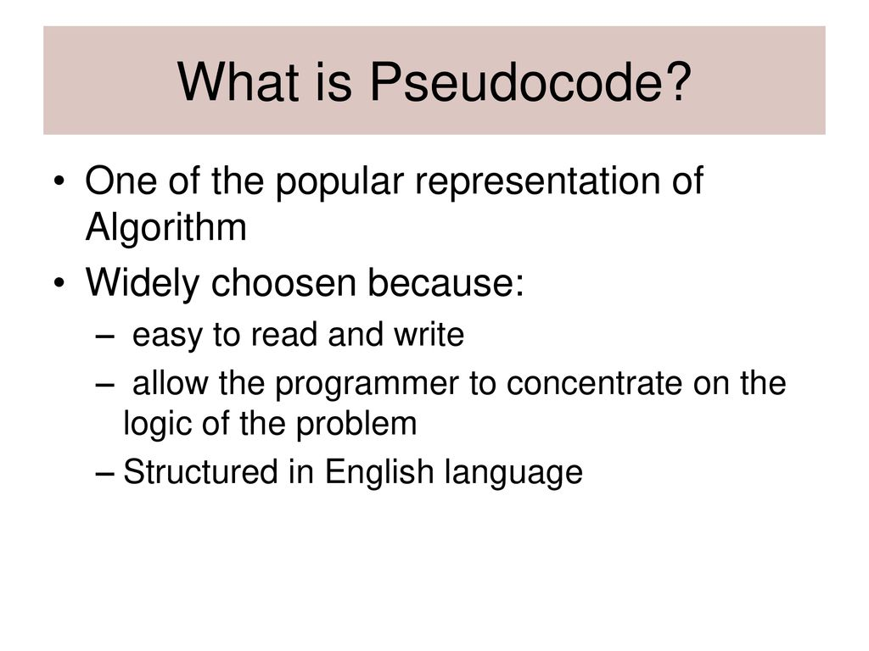
Pseudo code

Slide 52

Contd.

